Slide 1
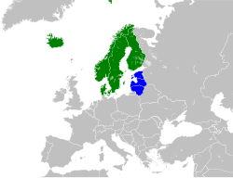

Sufficiency as Climate Action and for sustainable lifestyles in Nordic & Baltic Countries and Belarus Start-up Seminar, September 3-4

Slide 2
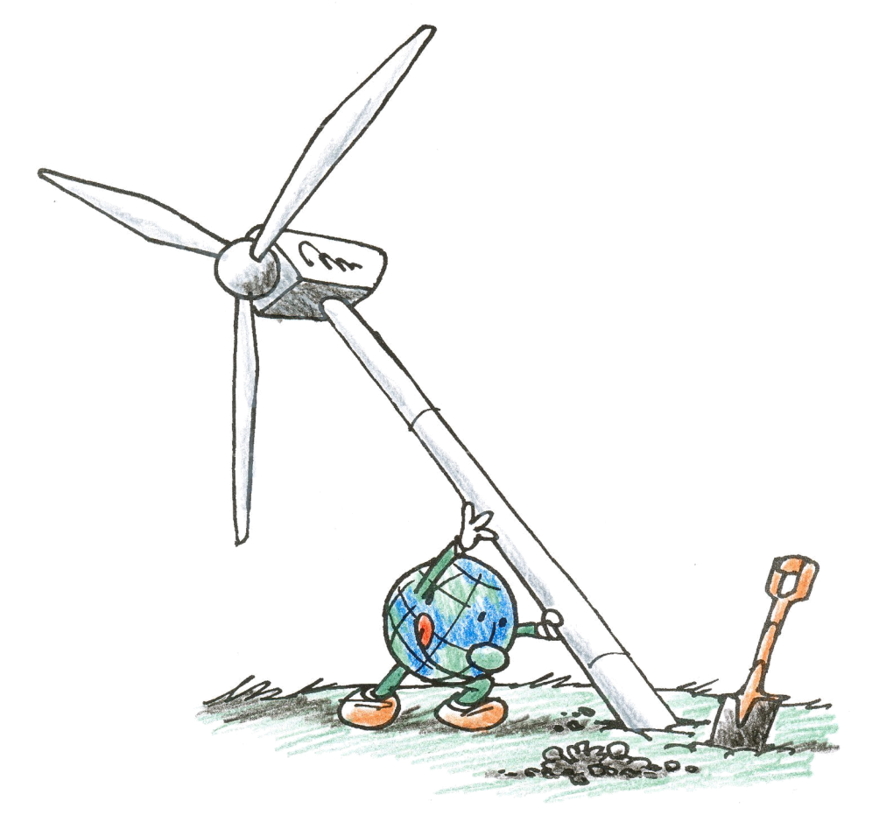
Start-up Seminar, September 3-4
September 3 at 9-12.30:
9.00 Welcome, check-in
9.15 Definition of sufficiency and policies & measures for sufficiency, presentation by Gunnar
9.45 Partner experiences with sufficiency, promotion of sufficiency, and policies for sufficiency, all partners
10.30 Short break
10.45 Timetable of project, including monthly meetings, seminars, milestones
Online platform for the project: shall we make a google drive or an alternative such as https://www.frama.space/abc/ or something else.
11.30 – 12.30 International outreach: presentation of negaWatt experiences with sufficiency by Yves Marignac, discussion (to be recorded)
September 4 at 13-16.30:
13.00 Division of work at each activity, coordinated by Gunnar
14.00 Review of conditions by the funder, Nordic Council of Ministers, presentation by Judit
14.30 Cooperation agreements between partners (as needed), coordinated by Gunnar
15.00 Break
15.15 Outreach activities, coordinated by Judit
15.45 Continued discussion of sufficiency, concluding from 3/9
Work on Description of sufficiency measures and identify how they can be promoted (activity 2)

Slide 3

Definition of sufficiency and policies & measures for sufficiency

Slide 4
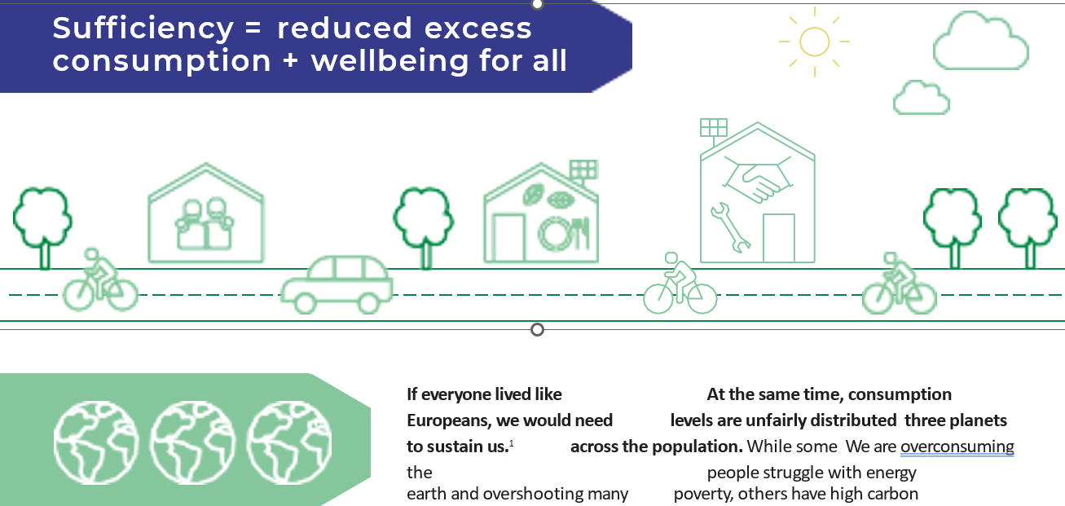

Slide 5
Sufficiency definition in the Nordic Baltic project: Integrating energy sufficiency into modelling of sustainable energy scenarios
● Keeping consumption within planetary boundaries by limiting the amount of consumption (avoid excessive over-consumption),
● Securing an amount of consumption that covers basic needs for all (avoid under-consumption).
● “Energy sufficiency involves reducing (voluntary or compulsory) consumption of energy services in order to minimise the associated environmental impacts” (Sorrell, Gatersleben, & Druckman, 2020).

Slide 6
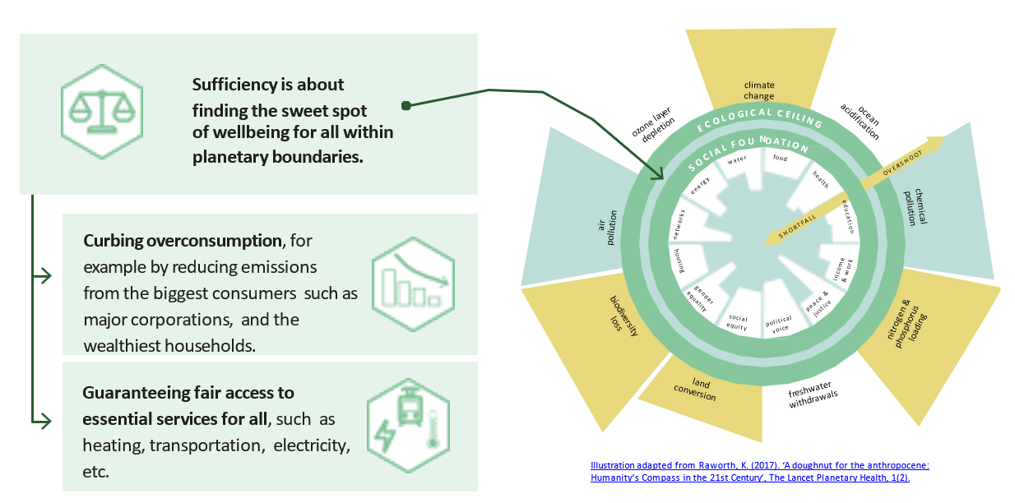

Slide 7
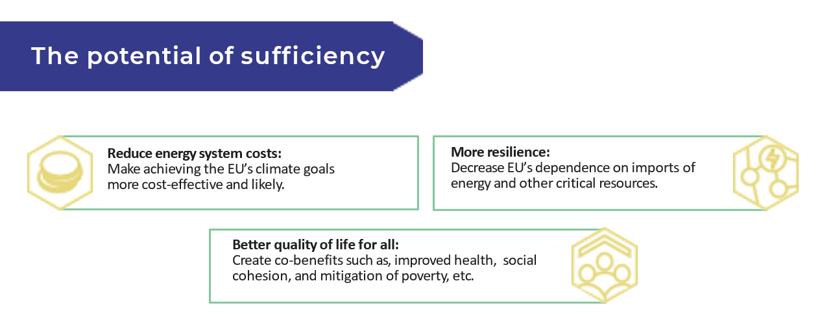

Slide 8
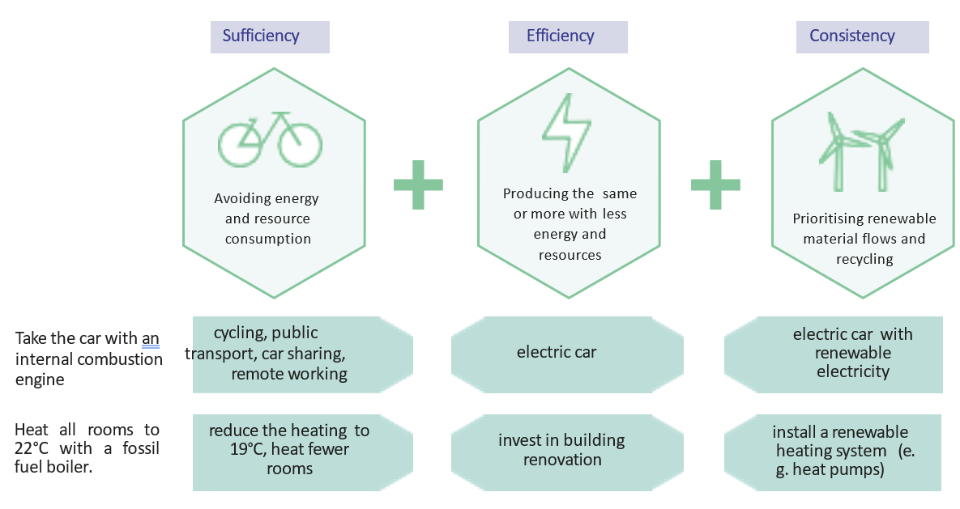
The role of sufficiency in energy & climate transition
Basis (no sufficiency):

Slide 9
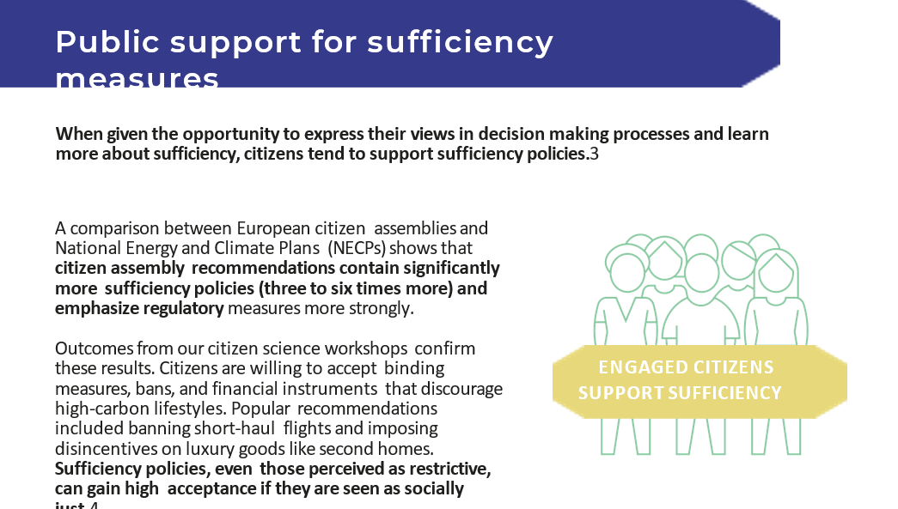

Slide 10
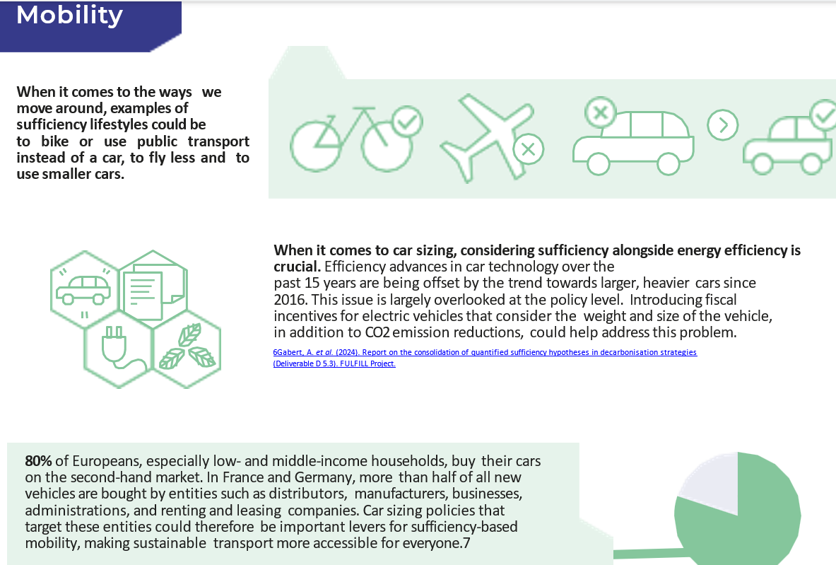
The four legs of sufficiency

Slide 11
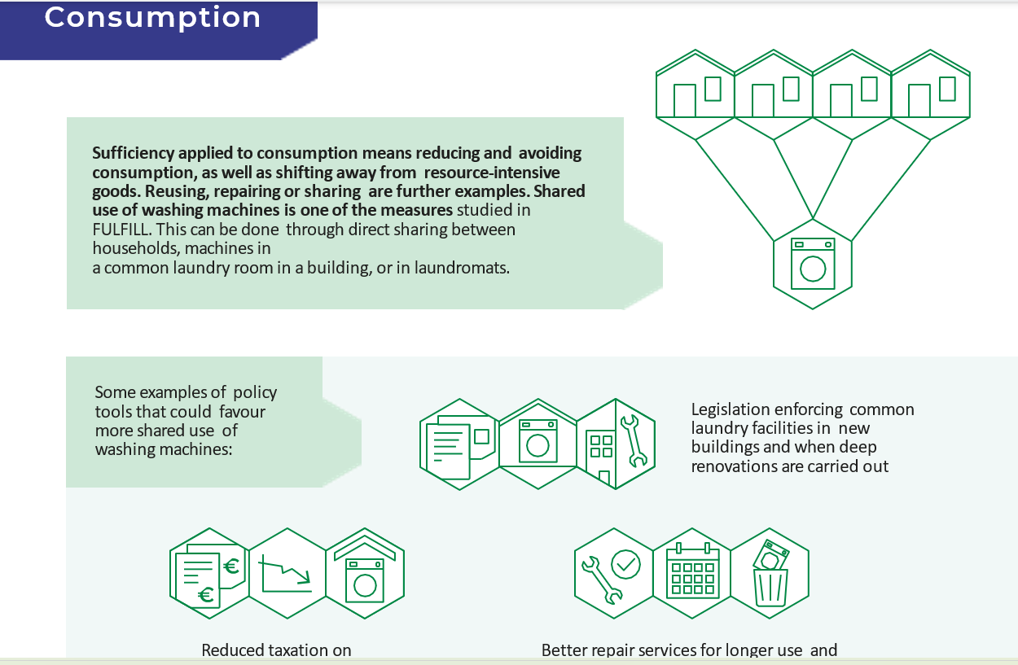
The four legs of sufficiency

Slide 12
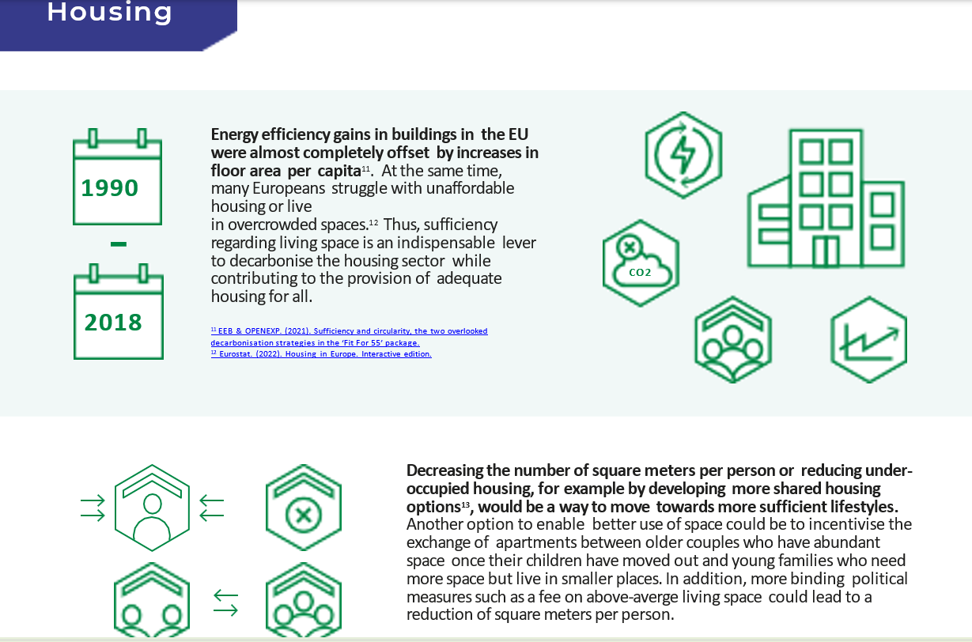
The four legs of sufficiency

Slide 13

The four legs of sufficiency

Slide 14
Activities in detail
2 Description of sufficiency measures and identify how they can be promoted
3 Organise dialogues on and introduction to sufficiency policies.
4 Developing national policy papers and a joint Nordic-Baltic CSO policy paper on sufficiency
5 Presentation to Nordic Council Committee for a Sustainable Nordic Region.
6 Online Start-up seminar
7 Seminar in Estonia, 20-21/4
8 Seminar in Denmark, proposal Second week of July starting 6/7 or end of August, week starting 17/8.
9 Outreach with websites, newsletters, social media, contact list.

Slide 15


Thank you

